Slide 1

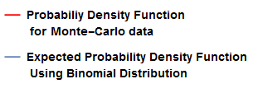
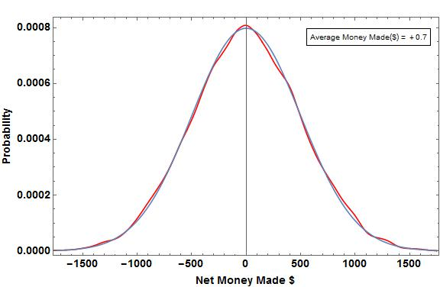
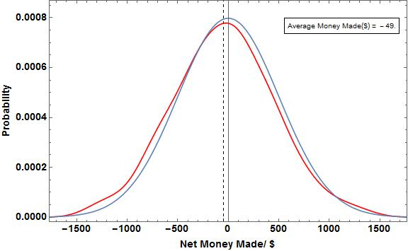
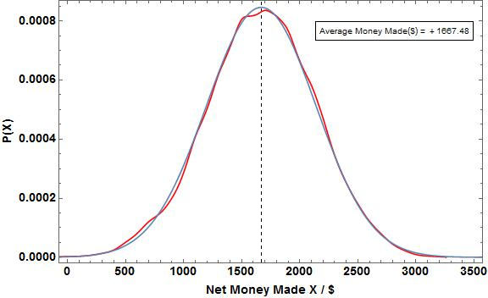
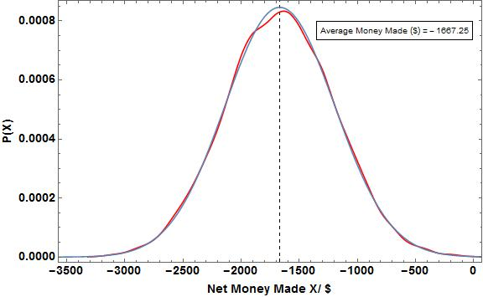
The Gambler’s Ruin: Mathematics of Risk-Taking
Omair Alam, Computational Methods in Physics, Spring 2015
Introduction:
Gamblers know that there are regular patterns to chance—although not all of their cherished beliefs survive mathematical analysis. In order to test the validity of their beliefs we using Monte-Carlo simulations to calculate the average earnings or losses in a game of die rolls under varying rules of winning. We further simulate a game of Craps with both a biased and unbiased die. For a dice roll game, we use a Binomial Distribution to model the expected earnings while for a Craps game, we use axiomatic derivations to calculate the expected probability of winning. We then compare the expected earnings with the actual earnings for a varying number of repetitions to understand the fate of the Gambler’s money after betting under certain game rules repeatedly.
Craps Simulation:
The rules of the Simulation for a single game of Craps are as follows:
If the sum of the two dies, X, is 7 or 11 we in the game
If X 2, 3 or 12, we lose the game
In X has any other value, we keep rolling two dies again till we either match that value of X again in which case we win, or we get a value of 7 for X, in which case we lose.
We simulate this game using both a fair and unfair die and calculate the probability of winning. We use an axiomatic derivation to calculate the expected probability of winning in both cases and compare these values for different number of trial runs
Results:
In Figure 1-4, the average money which is the physical mean of the data, represents the weighted average of all the Net Sums, X, made after each game (which consists of 100 trials).
For Figure 1, the average money made is very close to $0 because we used a fair die so using the Law of Large numbers, we will on average lose and gain an equal amount of money, resulting in an average net amount being very close to 0.
For Figure 3, the average money is a big positive number, because the probability of winning is twice that of losing. This means that on average we will be winning in more trials than losing.
For Figure 4, the average money is a big negative number, because the probability of losing is twice that of winning. This means we will be, on average, losing much more money than winning.
Figure 2 has the same die as Figure 1, but the only difference is that the number of repetitions in the latter are 100 times more that in the former. As per the Law of Averages, we get close to the expected value, which is 0 incase of a fair dye, as the number of repetitions become very large. Consequently, the average money made in Figure 1 is closer to the expected value as compared to that in Figure 2.
Table 2 also represents the same principal. As the number of trials increase, the estimated probabilities of winning with both fair and unfair dies get closer to the axiomatic (expected) probabilities.
Plots For Roll Die Game consisting of Expected and
Monte- Carlo Data
Legend
Physics and Methods:
Monte-Carlo methods were used as computational algorithms to approximate the probability of certain outcomes by running multiple trial runs using random variables.
We conducted two sets of experiments of which the first is related to rolling a die and the second is related to playing a game of Craps.
Die Roll Game Simulation:
The rules of the die roll game are as follows:
We start with a base amount i.e. the money we start the game with,
Every roll, if we get a favorable score, we gain a certain amount x, otherwise, we lose the same amount x,
We keep playing till we
Either get a net amount greater than a certain upper-bound amount Z representing having made enough to cash-out.
Or get a net amount lesser than a certain lower-bound amount Y representing having lost so much that more gambling isn’t possible
Or if we exhaust the number of trails per game representing not having more time to play.
Net Amount is defined as,
Net Amount = The Score of Each Game – base Amount
We find the frequencies of each net amount, and normalizing the data to get the probabilities of attaining each net amount as well as the average earing.
We use the following Normal Distribution Formula in order to find the expected earnings for each Net Amount.
Figure 1: Probability Distribution for a roll die game with a Fair Dye i.e. P(W) = P(L) for 10,000 repetitions of a game which consists of 100 trials. The Base Amount is $40,000, the score per win is $50, The lower-bound amount is $20,000 and the upper-bound amount is $80,000
Figure 2: Probability Distribution for a roll die game with a Fair Dye i.e. P(W) = P(L) 100 repetitions of a game which consists of 100 trials. The Base Amount is $40,000, the score per win is $50, The lower-bound amount is $20,000 and the upper-bound amount is $80,000
Figure 3: Probability Distribution for a roll die game with an Unfair Dye i.e. P(W) = 4/6 and P(L) = 2/6 10,000 repetitions of a game which consists of 100 trials. The Base Amount is $40,000, the score per win is $50, The lower-bound amount is $20,000 and the upper-bound amount is $80,000
Figure 4: Probability Distribution for a roll die game with an unfair Dye i.e. P(W) = 2/6, P(L) = 4/6 10,000 repetitions of a game which consists of 100 trials. The Base Amount is $40,000, the score per win is $50, The lower-bound amount is $20,000 and the upper-bound amount is $80,000
Conclusions or Discussion:
The Law of Large Numbers shows that playing with a fair die will lead us no gains, if we play a large number of games. Similarly, playing with a die in our favor will lead to a net gain and playing with a die in the favor of the house will lead to a net loss. Therefore, if we play a die roll game in a Casino our success depends more on the die we are playing with as opposed to the number of games we play since every roll of the die is an independent event and is not linked to any subsequent event.
Table Of Expected Values for Craps Expected and
Monte- Carlo Data
Number of Trials | Estimated Probability of winning with Fair Die | Expected Probability of winning with fair Die | Estimated Probability of winning with Unfair Die | Expected Probability of winning with Unfair Die
10 | 0.600 | 0.493 | 0.800 | 0.524
10000 | 0.498 | 0.493 | 0.532 | 0.524
100000 | 0.491 | 0.493 | 0.524 | 0.524
References:
Text 1 that was used
Article 2 that was used
Reference 3 that was use
Table 1: The Fair die has equal probability of 1,2,3,4,5 and 6.
The unfair die has P(1) = 1/13, P(2) = 2/13, P(3) / 2/13, P(4) = 2/13, P(5) = 2/13 and P(6) = 4/13

